Slide 1
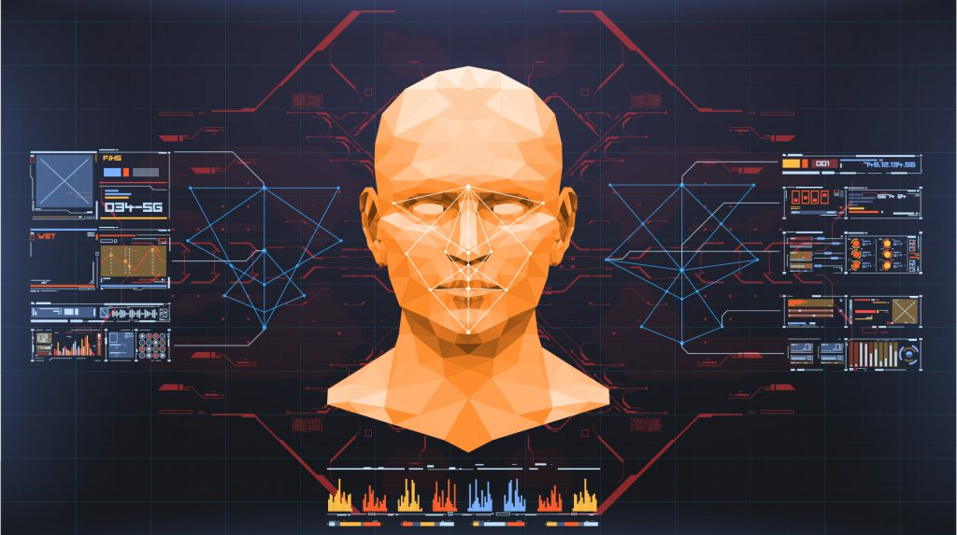
Face Recognition Attendance System

Slide 2
MADE BY:-
NAME:- BALA KRISHNA CHENNAIAH
REGD NO. :- 121912501006
CLASS:- BCA-3/3 – ‘A’
GUIDE NAME:- MRS. B SATYA SAI VANI

Slide 3
ABSTRACT:-
The main purpose of this project is to build a face recognition-based attendance monitoring system for educational institution to enhance and upgrade the current attendance system into more efficient and effective as compared to before.
The current old system has a lot of ambiguity that caused inaccurate and inefficient of attendance taking.

Slide 4
Many problems arise when the authority is unable to enforce the regulation that exist in the old system.
The technology working behind will be the face recognition system. The human face is one of the natural traits that can uniquely identify an individual.

Slide 5
Therefore, it is used to trace identity as the possibilities for a face to deviate or being duplicated is low. In this project, face databases will be created to pump data into the recognizer algorithm.
Then, during the attendance taking session, faces will be compared against the database to seek for identity.

Slide 6
When an individual is identified, its attendance will be taken down automatically saving necessary information into a excel sheet.
At the end of the day, the excel sheet containing attendance information regarding all individuals are mailed to the respective faculty.

Slide 7
Software Requirements:
Windows 10
Anaconda
CSV file reader(MS Excel)
Some Python Libraries
Camera (Web Cam)

Slide 8

LIST OF PYTHON LIBRARIES REQUIRED:
Dlib
dlib is a toolkit for making real world machine learning and data analysis applications in C++. While the library is originally written in C++, it has good, easy to use Python bindings.

Slide 9
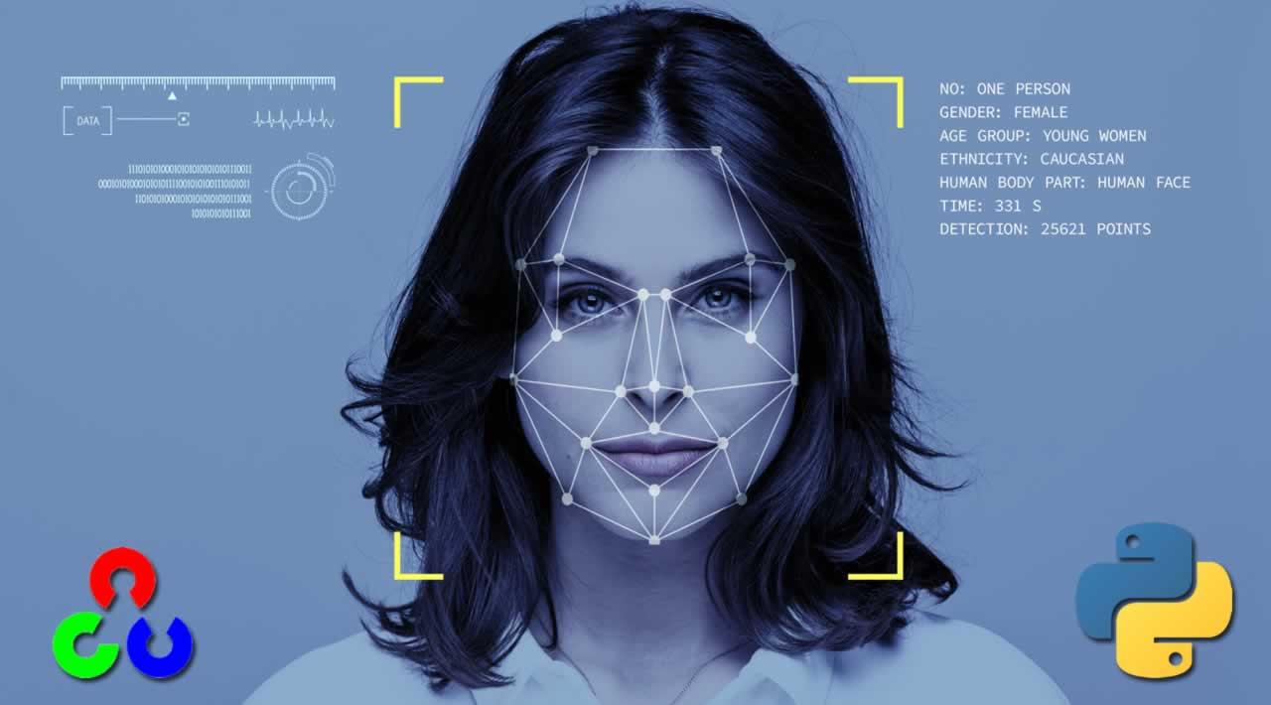
face_recognition
Recognize and manipulate faces from Python or from the command line with. the world's simplest face recognition library. Built using dlib's state-of-the-art face recognition. built with deep learning.

Slide 10

Opencv
OpenCV is a great tool for image processing and performing computer vision tasks. It is an open-source library that can be used to perform tasks like face detection, objection tracking, landmark detection, and much more. It supports multiple languages including python, java C++.

Slide 11
SOME OTHER LIBRARIES FOR BETTER FUNCTIONALITY:
certifi
chardet
click
decoratorface-recognition
face-recognition-models
idna
imageio
imageio-ffmpeg
moviepy
numpy
opencv-python
Pillow
proglog
requests
tqdm
urllib3
wincertstore

Slide 12
Hardware Components Requirements:
Processor – i3
Hard Disk – 5 GB
Memory – 1GB RAM

Slide 13
Advantages:
The software can be used for security purposes in organizations and in secured zones.
The software stores the faces that are detected and automatically marks attendance.
The system is convenient and secure for the users. • It saves their time and efforts.

Slide 14
Disadvantages:
The system don’t recognize properly in poor light so may give false results.
It can only detect face from a limited distance.

Slide 15
Applications:
The system can be used for places that require security like bank, military etc.
It can also be used in houses and society to recognize the outsiders and save their identity.
The software can used to mark attendance based on face recognition in organizations.

Slide 16
REQUIREMENT ANALYSIS DOCUMENT:-

Slide 17
INTRODUCTION:
Every organization requires a robust and stable system to
record the attendance of their students and every
organization have their own method to do so, some are
taking attendance manually with a sheet of paper by
calling their names during lecture hours and some have
adopted biometrics system such as fingerprint, RFID card
reader, Iris system to mark the attendance.

Slide 18
The conventional method of calling the names of students manually is time consuming event.
The RFID card system, each student assigns a card with their corresponding identity but there is chance of card loss or unauthorized person may misuse the card for fake attendance.
While in other biometrics such as finger print, iris or voice recognition, they all have their own flaws and also they are not 100% accurate

Slide 19
1.1 PURPOSE of the System
A face recognition attendance system makes use of facial recognition technology to identify and verify a person and mark attendance automatically. ... A facial recognition attendance system is a contactless technology that provides freedom from any physical interaction between the man and the machine.

Slide 20
1.2 SCOPE of the System
The main objective of this project is to offer system that simplify and automate the process of recording and tracking students' attendance through face recognition technology.
It is biometric technology to identify or verify a person from a digital image or surveillance video.

Slide 21
1.3 OBJECTIVE AND SUCCESS CRITERIA OF THE SYSTEM
Instead of using the conventional methods, this proposed system aims to develop an automated system that records the student's attendance by using facial recognition technology.
The main objective of this work is to make the attendance marking and management system efficient, time saving, simple and easy.

Slide 22
1.4 REFERENCES:
[1] ttps://www.researchgate.net/publication/326261079_Face_detection_
system_for_attendance_of_class’_students
[2] Hapani, Smit, et al. "Automated Attendance System Using Image
Processing." 2018 Fourth International Conference on Computing
Communication Control and Automation (ICCUBEA). IEEE, 2018.
[3] Akbar, Md Sajid, et al. "Face Recognition and RFID Verified
Attendance System." 2018 International Conference on Computing,
Electronics & Communications Engineering (iCCECE). IEEE, 2018.

Slide 23
[4] Okokpujie, Kennedy O., et al. "Design and implementation of a
student attendance system using iris biometric recognition." 2017
International Conference on Computational Science and
Computational Intelligence (CSCI). IEEE, 2017.
[5] Rathod, Hemantkumar, et al. "Automated attendance system using
machine learning approach." 2017 International Conference on
Nascent Technologies in Engineering (ICNTE). IEEE, 2017.
[6] Siswanto, Adrian Rhesa Septian, Anto Satriyo Nugroho, and
Maulahikmah Galinium. "Implementation of face recognition
algorithm for biometrics based time attendance system." 2014
International Conference on ICT For Smart Society (ICISS). IEEE,
2014.

Slide 24
[7] Lukas, Samuel, et al. "Student attendance system in classroom using
face recognition technique." 2016 International Conference on
Information and Communication Technology Convergence (ICTC).
IEEE, 2016.
[8] https://becominghuman.ai/face-detection-using-opencv-with-haar-
cascade-classifiers-941dbb25177
[9] https://www.superdatascience.com/blogs/opencv-face-recognition
[10] Salim, Omar Abdul Rhman, Rashidah Funke Olanrewaju, and Wasiu
Adebayo Balogun. "Class attendance management system using face
recognition." 2018 7th International Conference on Computer and
Communication Engineering (ICCCE). IEEE, 2018.

Slide 25
2.CURRENT SYSTEM:
Traditional attendance marking techniques i.e, pen and paper or signing attendance sheets are easy to bypass and trick as giving proxies or false signatures is a common practice among students nowadays, students take an unfair advantage of this at most times. But a facial recognition system is unassailable and cannot be fooled as each person has a set of unique and individual features common to that person and cannot be replicated or changed, it all comedown to one simple truth that is, unless you are physically present in the lecture your attendance will not get marked.

Slide 26
3.PROPOSED SYSTEM:
In the proposed system, initially all the students will be enrolled by storing their facial images with a unique ID. ... Local Binary Patterns Histogram (LBPH) algorithm is used for face recognition and training the stored dataset, that generates the histogram for stored images and the real time image.

Slide 27
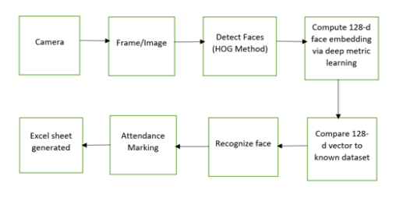
3.1 OVERVIEW:
Face recognition involves two steps, first step involves
the detection of faces and second step consist of
identification of those detected face images with the
existing database.

Slide 28
3.2 Functional Requirements:
Taking and tracking student attendance by facial recognition in specific time.
Sending the names of the absent student directly to the lecturer
Permitting the lecturer to modify the student absent or late.
Showing the names of who is absent or late in the screen to avoid errors.

Slide 29
3.3 Non-functional requirements:
Accuracy and Precision: the system should perform its process in accuracy and Precision to avoid problems.
Modifiability: the system should be easy to modify, any wrong should be correct.
Security: the system should be secure and saving student’s privacy.
Usability: the system should be easy to deal with and simple to understand.
Maintainability: the maintenance group should be able to fix any problem occur suddenly.
Speed and Responsiveness: Execution of operations should be fast.

Slide 30
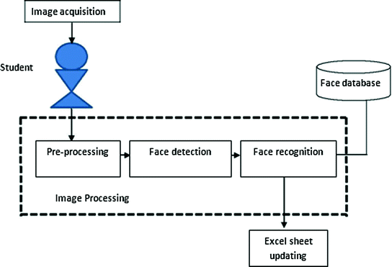
3.4 SYSTEM MODEL:

Slide 31
THANK YOU

